Slide 1

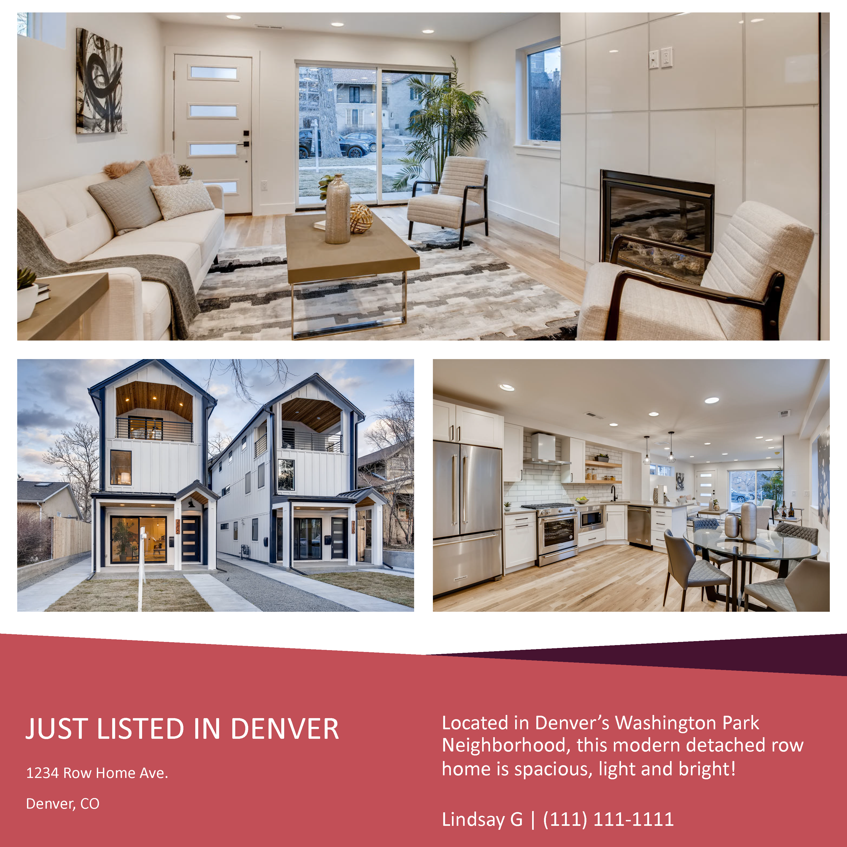
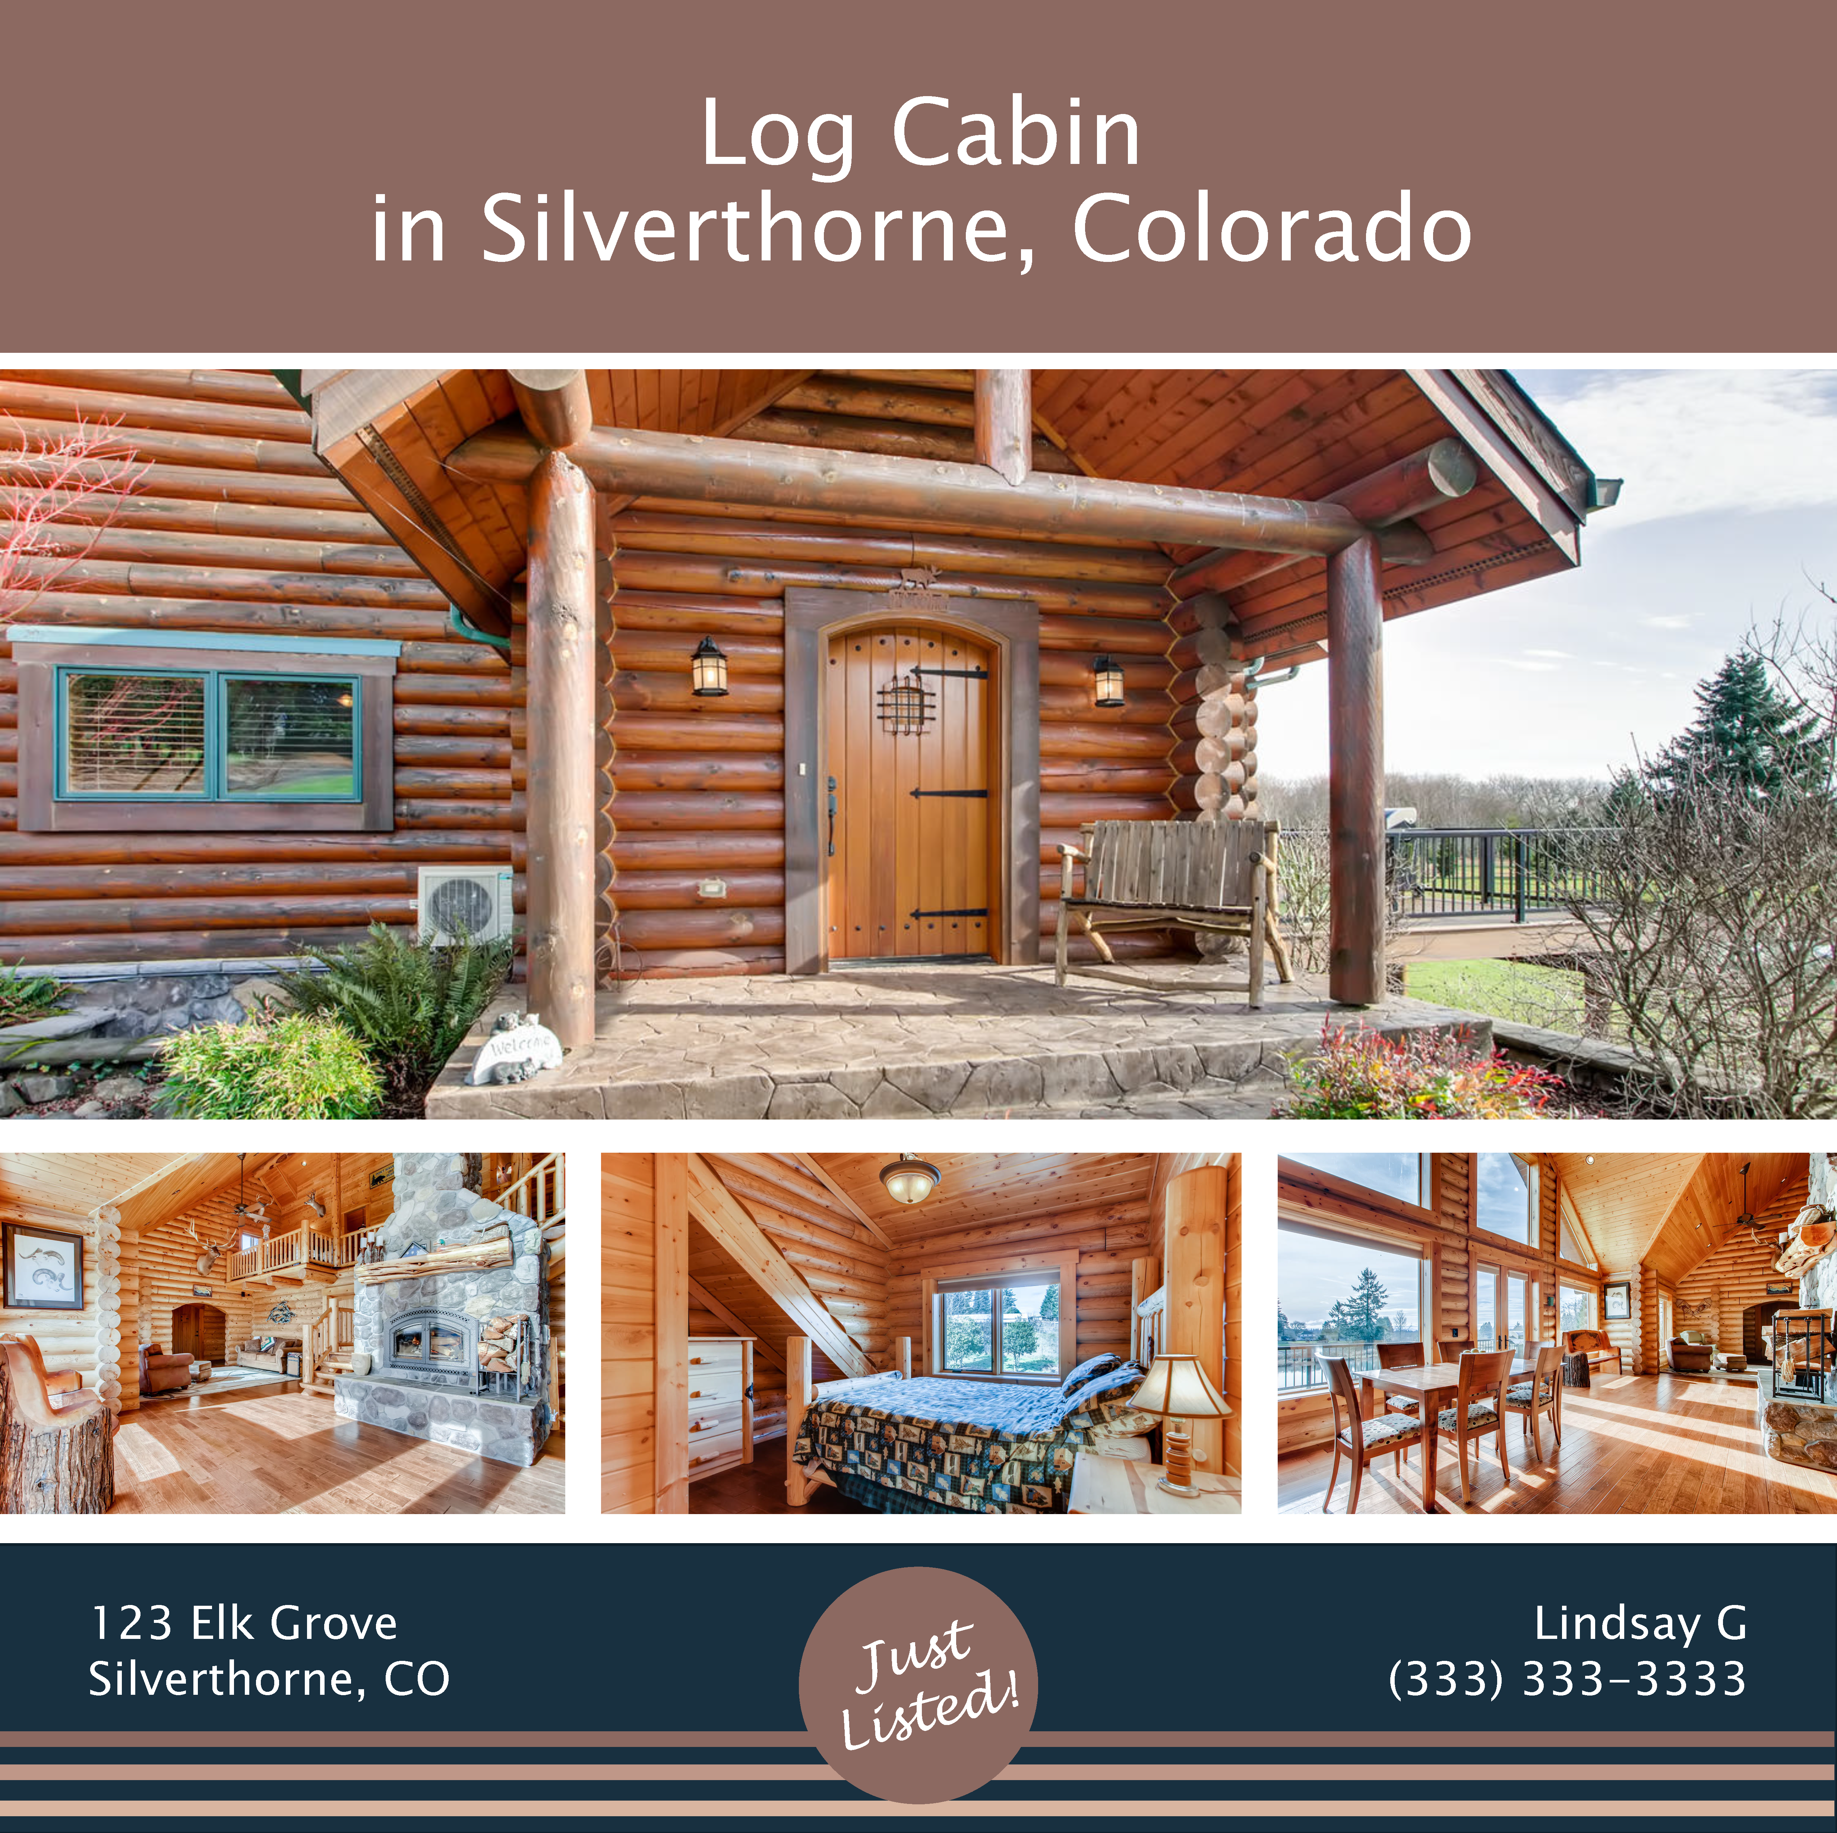

LOVE YOUR LISTINGS:
5 NEW DIGITAL LISTING TEMPLATES

Slide 2





WHERE TO USE YOUR NEW LISTING TEMPLATE
Facebook - on your personal feed as well as your real estate business page and real estate group pages
Instagram - as a post or an Instagram Stories highlight
Twitter - tweet it out! And use relevant hashtags!
Email - easily send your listing to your network and subscribers
ADDING AND REPLACING IMAGES
To ADD an image to an image placeholder
Click the image placeholder on the slide
Click the picture icon
Select the image you want to insert from your computer
To REPLACE an image
To avoid formatting issues, use the following steps to replace an image:
Select the image you want to replace
Right click and select CUT
The placeholder icon will reappear.

Slide 3
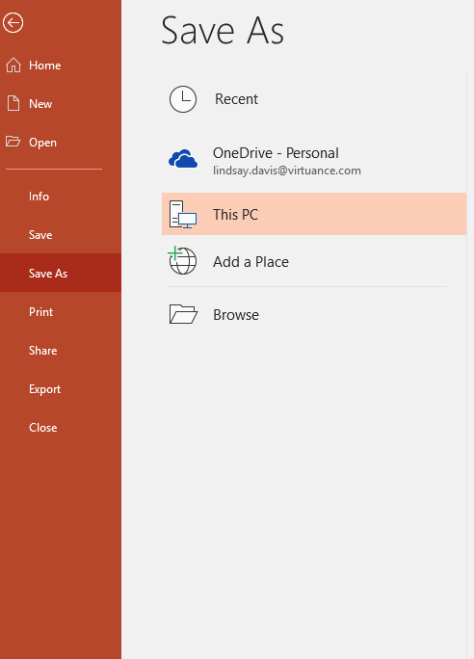
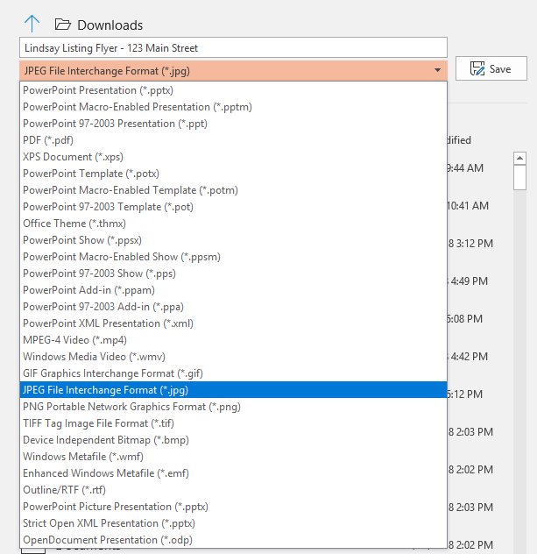
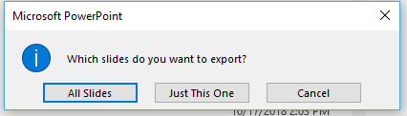
SAVING YOUR TEMPLATE
How to save your template as an image:
Each page is it’s own separate listing flyer
Select FILE and SAVE AS
Rename your listing flyer (Name, listing address, etc.)
Select an image file to save the flyer under like .jpg or .png
Click SAVE
When prompted, select JUST THIS SLIDE
2
3
4
1
5

Slide 4

ADDITIONAL RESOURCES FOR
MICROSOFT POWERPOINT HELP
HOLD DOWN CTRL TO FOLLOW THE LINKS
How to learn PowerPoint quickly (complete beginner’s guide)
Beginner’s guide to PowerPoint – 2017 Tutorial (YouTube)
Enjoy this template packet and let me know if I can help!
Lindsay Davis
Marketing Coordinator
Lindsay.davis@virtuance.com

Slide 5
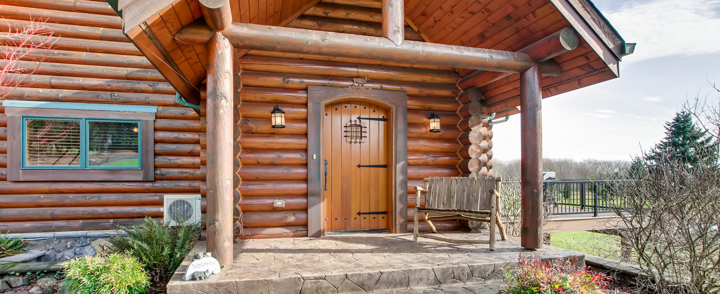
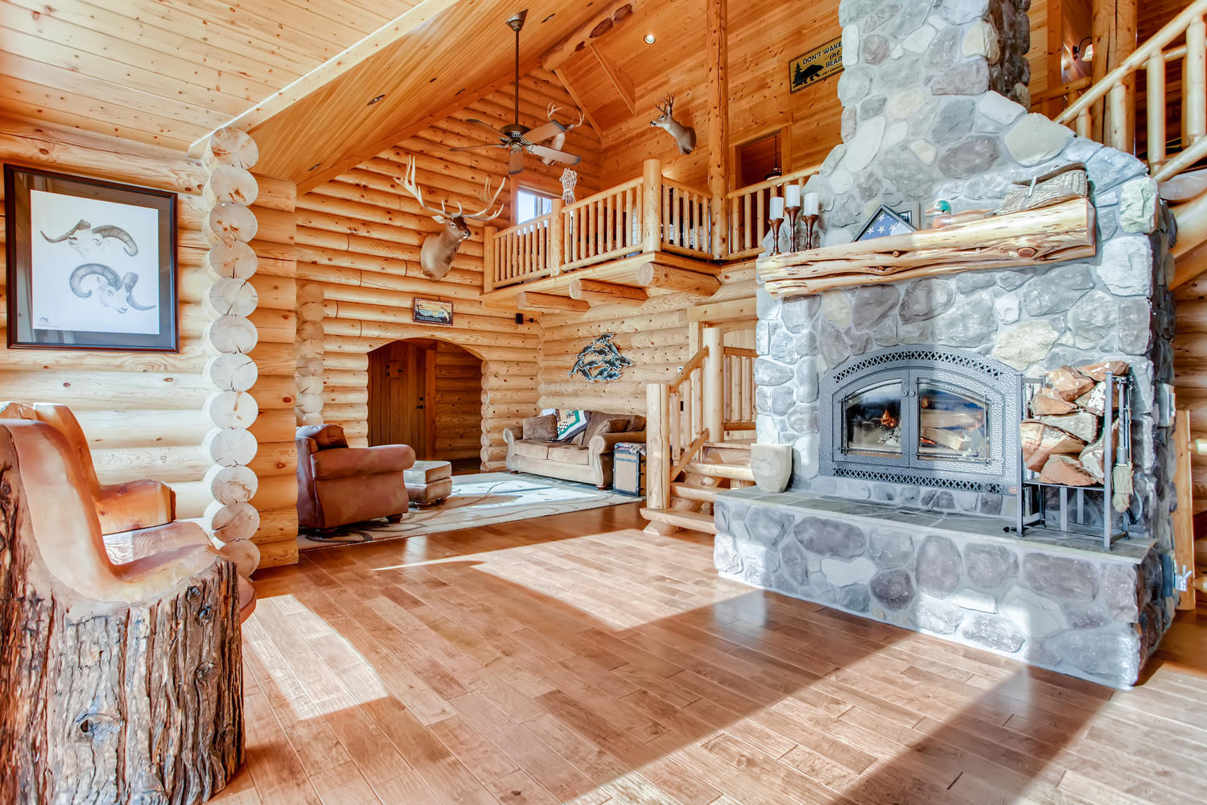
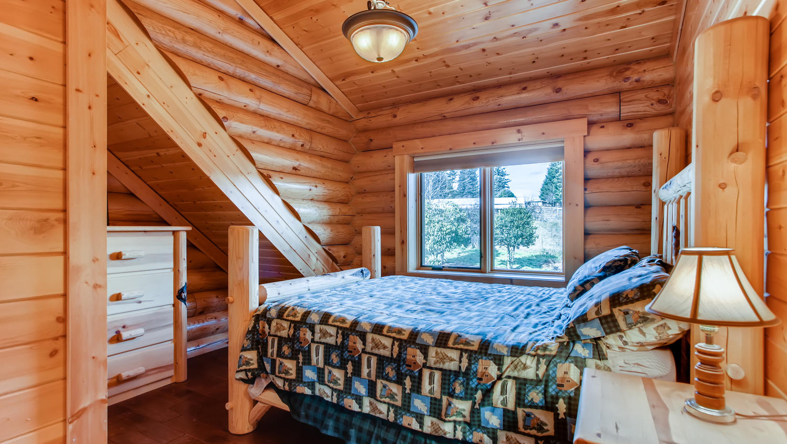
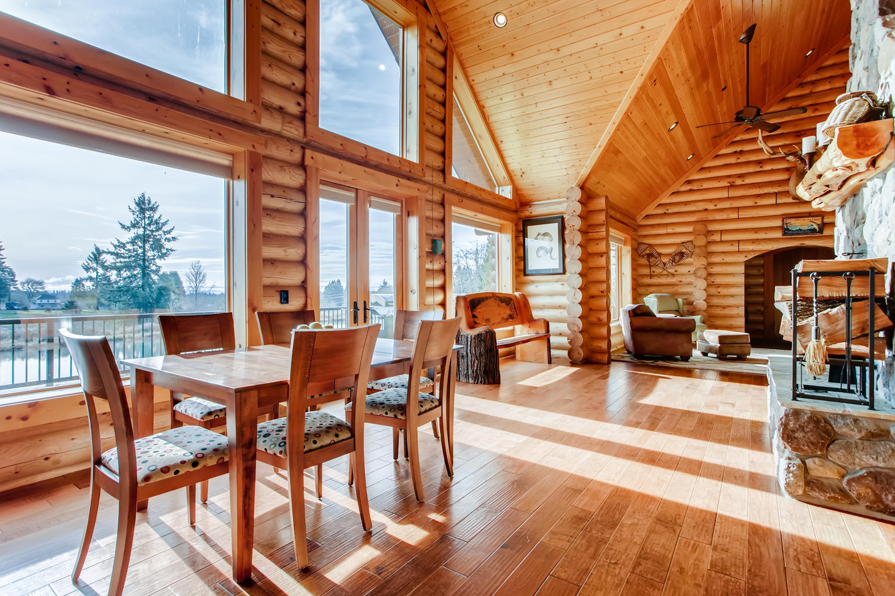
Log Cabin
in Silverthorne, Colorado
123 Elk Grove
Silverthorne, CO
Lindsay G
(333) 333-3333

Slide 7
Description of House in City Name
Just Listed!

Slide 8
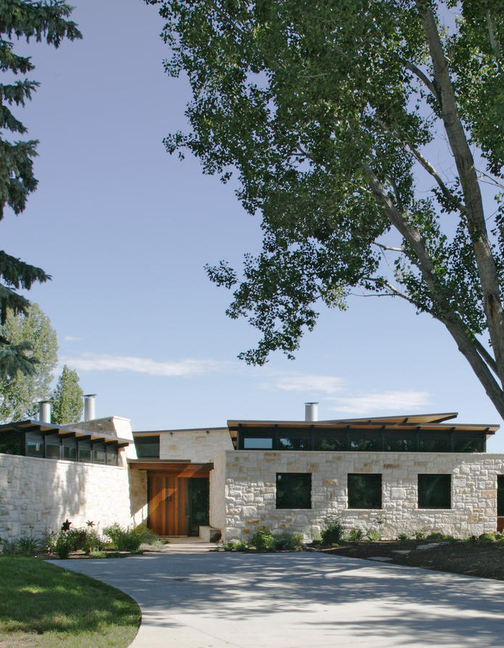
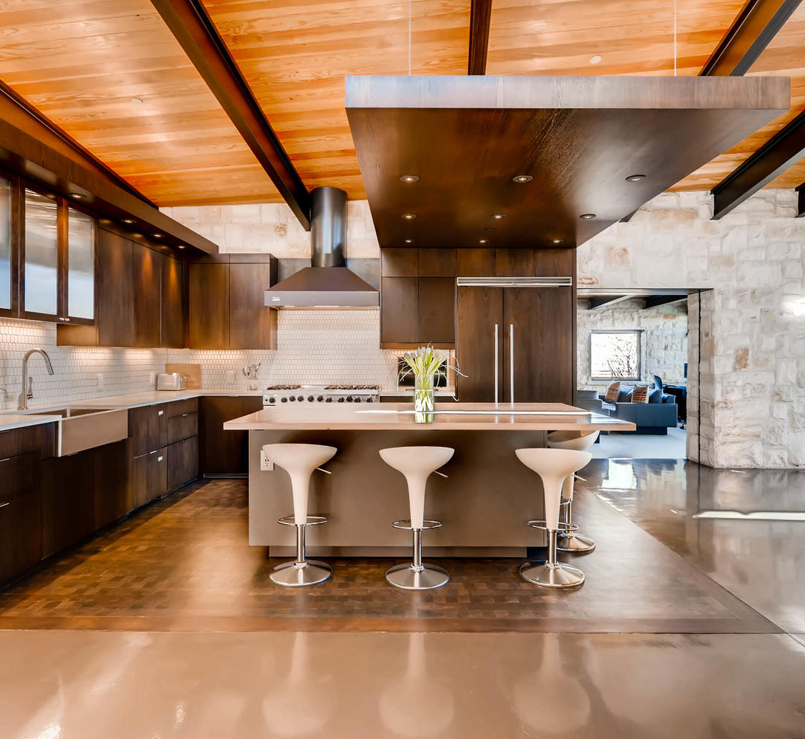
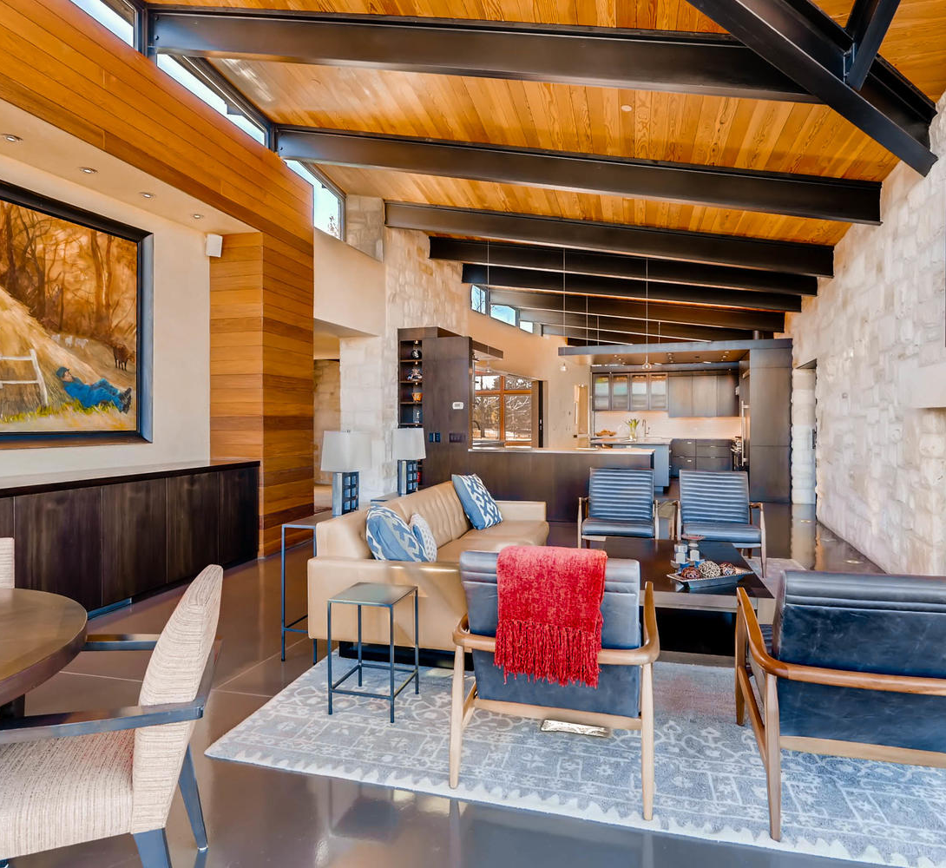
MID-CENTURY MODERN
IN BOULDER, COLORADO
Lindsay G | (111) 123-4567
My Agency Name
www.mylistings.com
1234 Flat Iron Ave., Boulder, Colorado

Slide 11
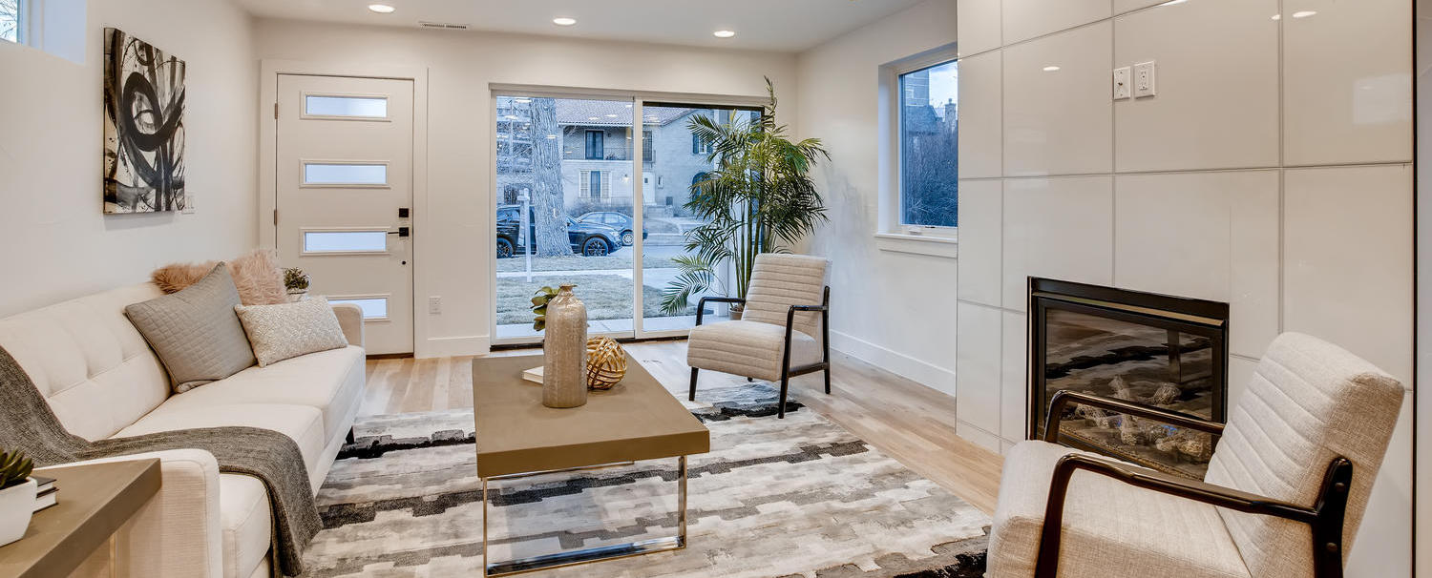
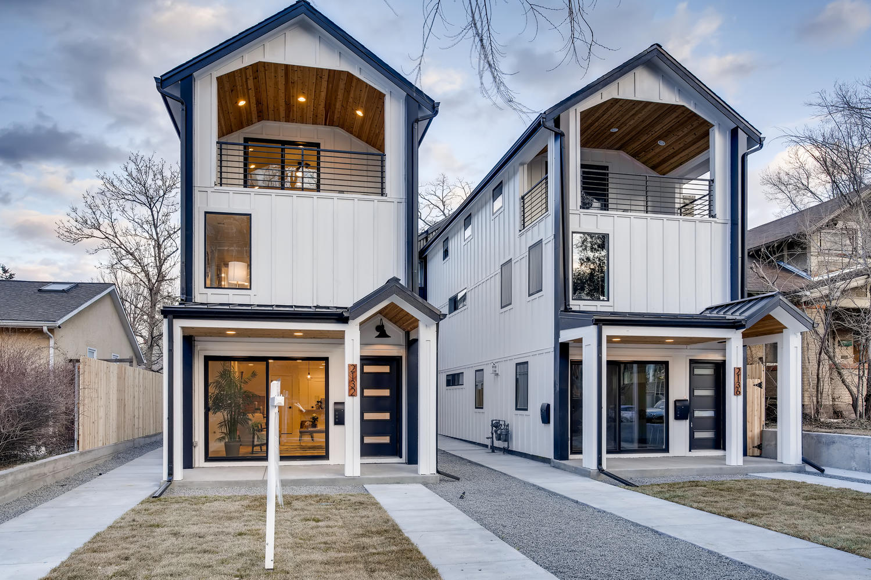
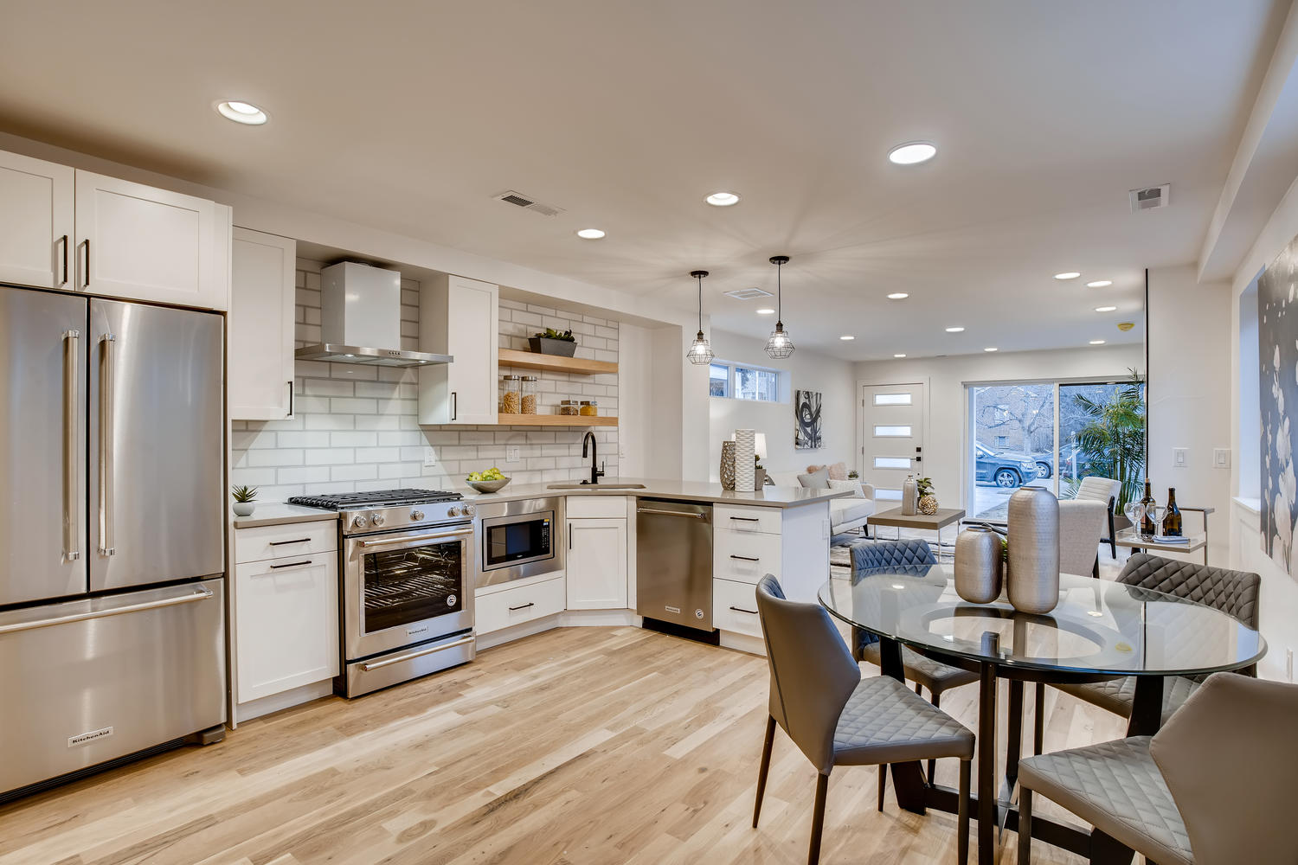
JUST LISTED IN DENVER
Located in Denver’s Washington Park Neighborhood, this modern detached row home is spacious, light and bright!
1234 Row Home Ave.
Denver, CO
Lindsay G | (111) 111-1111

Slide 14
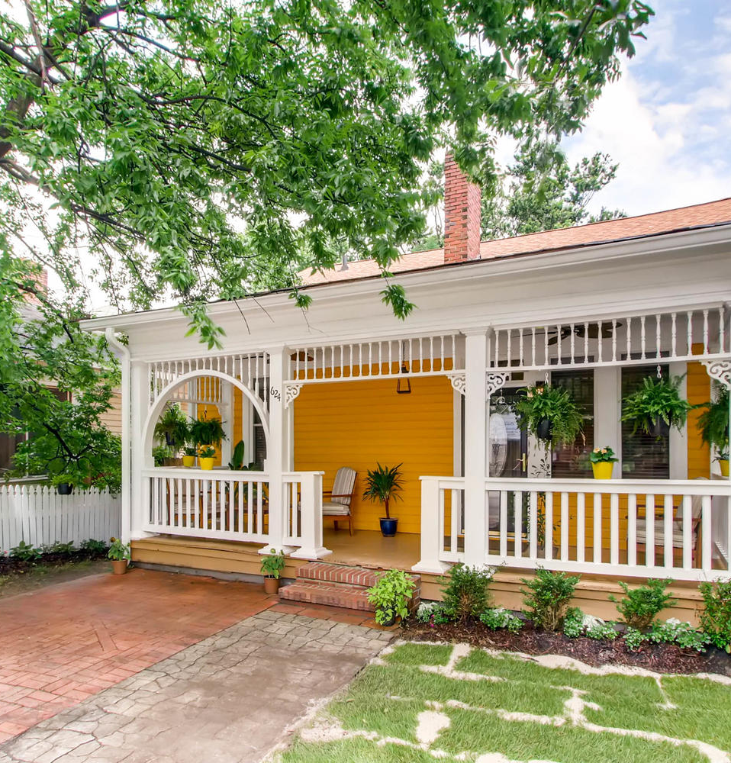
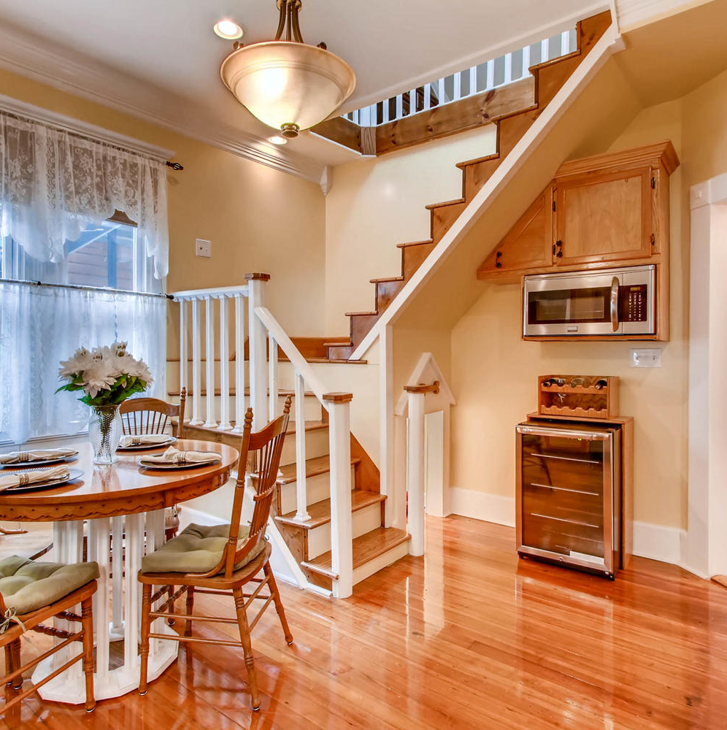

JUST LISTED
IN ATLANTA
A tiny southern gem sits in the Historic Cabbagetown neighborhood of Atlanta, GA. This beautifully restored 3 bed / 2 bath home has 3 fireplaces to cozy up to in the winter and spacious front and back porches to pass time on hot summer days.
The ceilings on the main floor are over 10 feet, which makes the small space feel incredibly roomy. The second-floor bonus room may surprise many homebuyers based solely on the exterior view of the home.
Lindsay G | (111) 111-1111
My Agency
www.mylistings.com

Slide 17

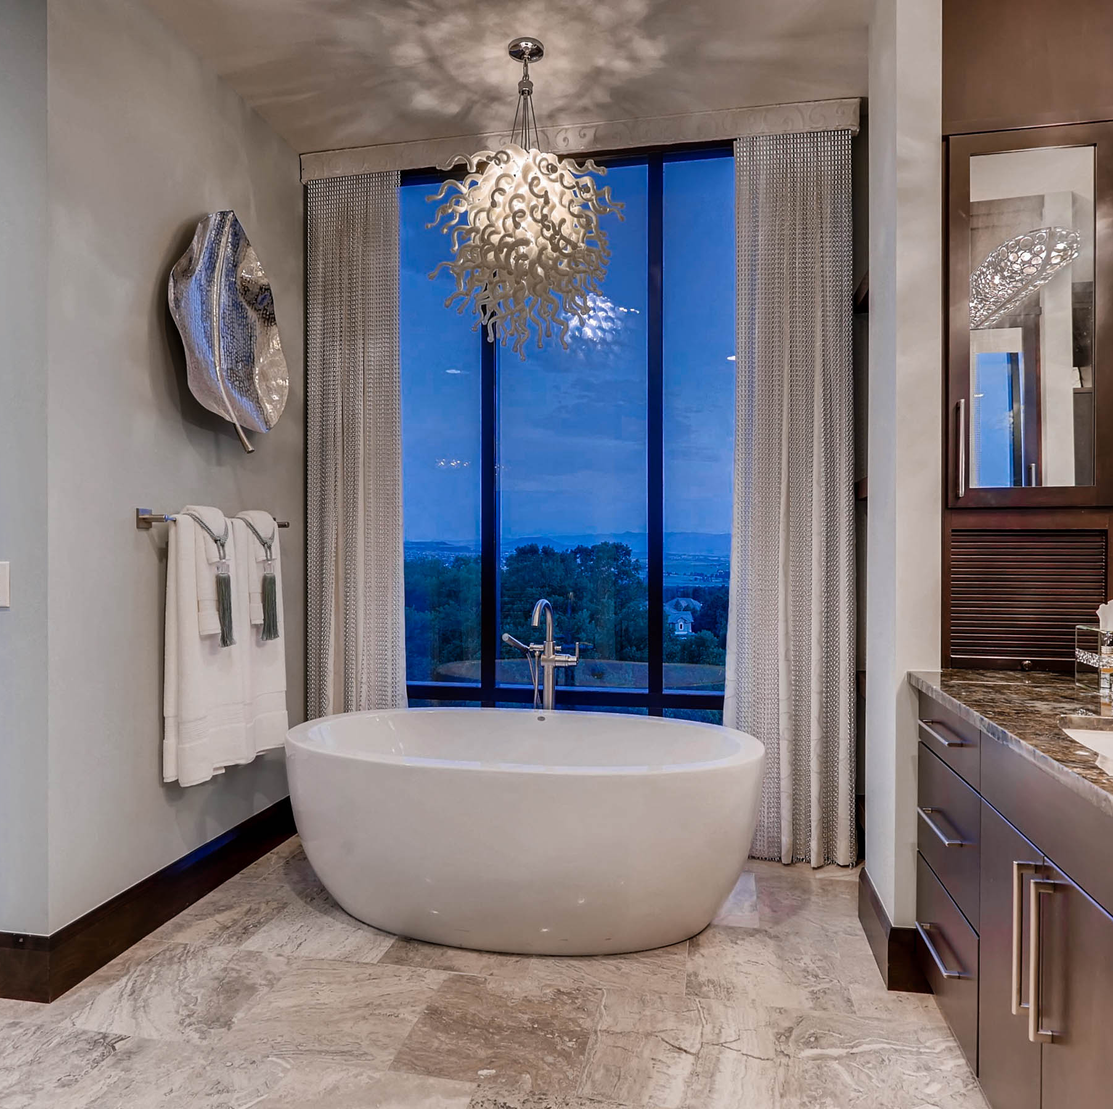
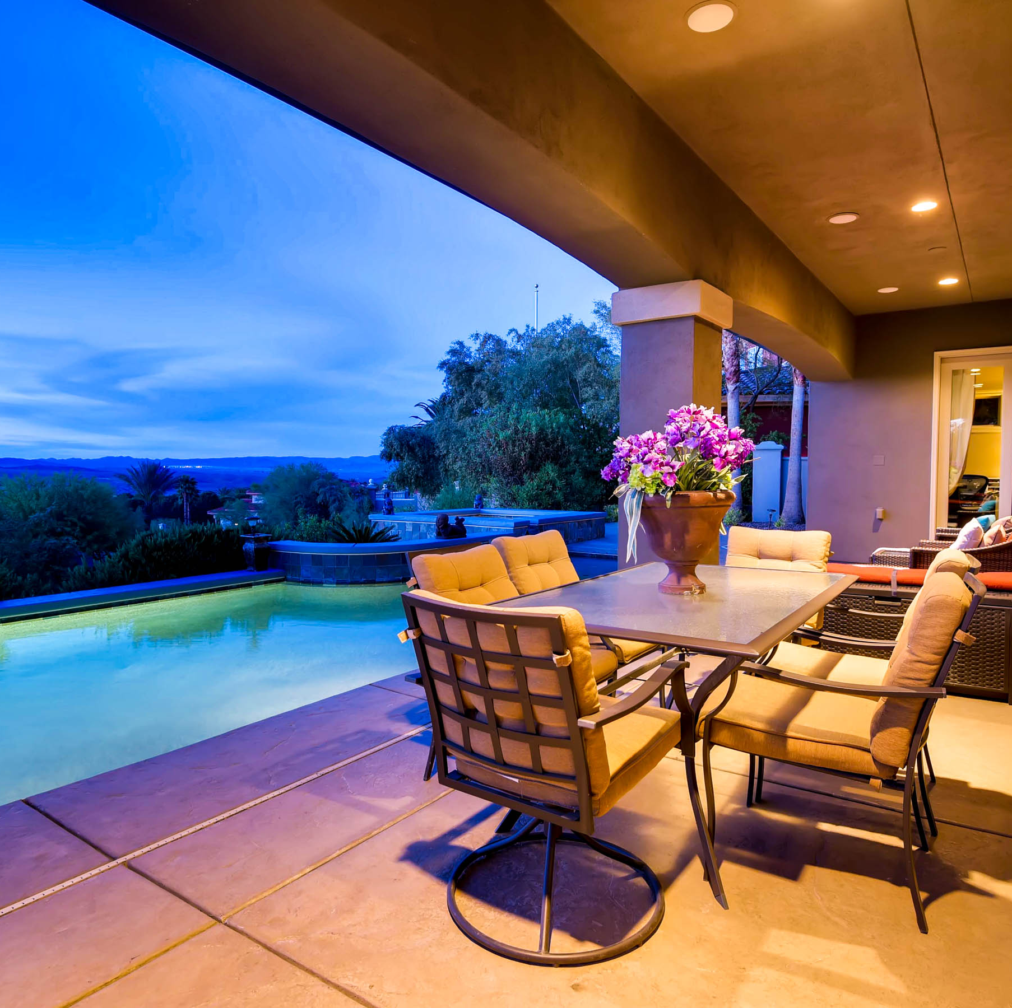

Beautiful New Home in Nashville
123 Twilight Ln. | Nashville, TN
Lindsay G
(111) 111-1111

Slide 18
New Listing Address

